Slide 1
Piano In Basic C programming

Slide 2
Introduction:-
C program for piano is program to implement piano game in c. We use our keyboard as a piano and pressing key will generate different type of sound. for this program we have to include dos.h header file in program. This file provides functions for producing sounds.

Slide 3
Description:-
To develop piano in c we use some different functions from dos.h which are as follows
Sound function in c:
This function is used to produce sound with different frequency.
Syntax:
sound(any number);
Example : sound(1200)
Delay function in c:
This function is used to delay sound generated by sound.

Slide 4
Requirement:-
Software :-
Operating System : Windows 7
Turbo C++
Notepad
Hardware:-
1) Processer: Intel(R) core i3 CPU
2) RAM: 512 MB and Above.
3) Hard Disk: 80 GB and Above.

Slide 5
Algorithm for Piano :-
Start
Take input that user want to play or stop
Write switch case with different keyboard key
Write sound function in case with different number
End

Slide 6
Header files:-
#include<stdio.h>
#include<stdlib.h>
#include<dos.h>
#include"tune2.h"
#include"tunetype.h"
#include"airtel.h"

Slide 7
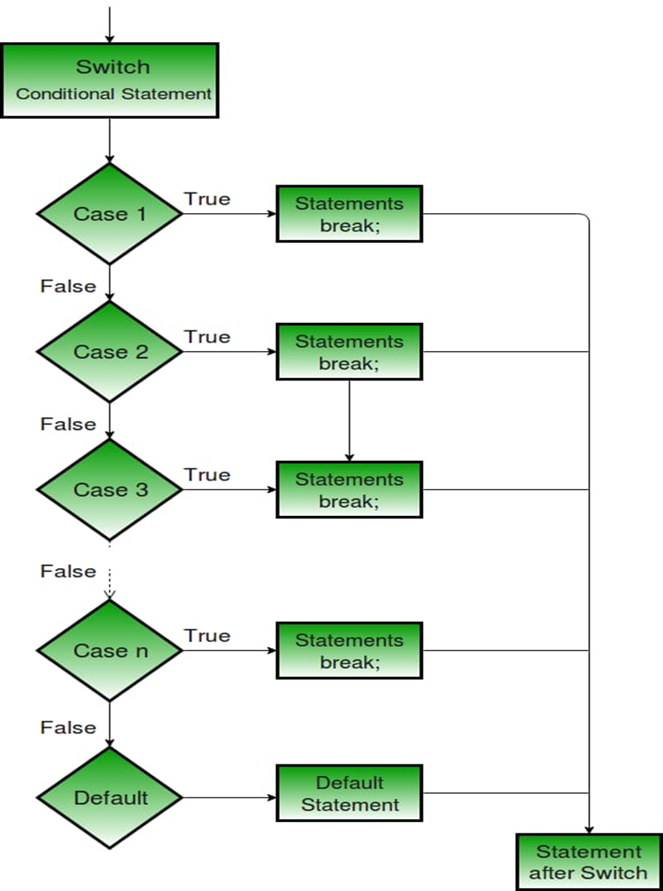
Flow Chart:-

Slide 8
Keyboard Piano Program:-
Line 1-3: Very first three lines of source code include header files, among three header files “dos.h” header file has vital function which will do our task. Line-4: Forth line is “void main()” which is the main function of our program and program execution will begin from here. Line-5: Fifth line is opening brace of main program. Line-6: In sixth line a character variable has been declared and initialized with character ‘y’.

Slide 9
Line-7: Next line clears the any previous output from output screen. Line-8: The eighth line prints a line informing user that if he needs to close this program then he/she should press Capital X. Line-9: Next line is a while loop which keeps looping four lines in it until we press X. Line-10: Beginning of while loop.

Slide 10
Line-11: In this line of code we store the ASCII value of key pressed by user during runtime. For example if user presses ‘p’ key on keyboard then its corresponding ASCII value, 113 gets store in ‘ch’ variable. Line-12: The “sound()” will produce sound from pc speaker and in bracket we need to set frequency at which it will buzz. Here we are multiplying 10 with ASCII value available in ch variable. You can change the constant ‘10’ in this line to different integer value and as a result it will change the sound output. Do experiment only with this value.

Slide 11
Line-13: Here “delay()” function determines how long the sound will last (Note: actually “ delay()” function suspends the execution of program). This is determined by value provided in bracket. In our example I have set 75 milliseconds. If you change it to 3000 then sound will be played for 3 seconds. Line-14: The “nosound()” function works opposite of “sound()” function. It turns off PC speaker. If we won’t use this in our program then speaker will keep buzzing until we close program.

Slide 12
Line-15: End of while loop. Line-16: End of “main()” function.

Slide 13
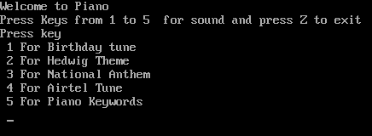
Snapshot:-

Slide 14
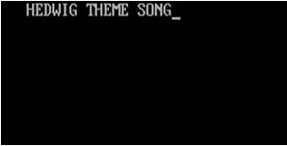
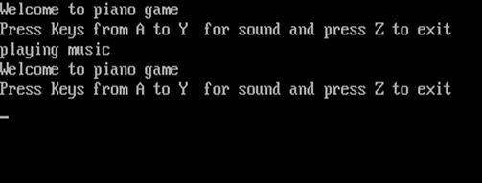
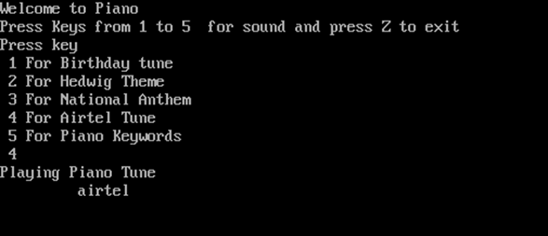
Snapshot:-

Slide 15
Reference:-
http://embedded-lab.com/blog/lab-19-play-musical-notes/
https://www.youtube.com/watch?v=bYdlKtONMm0

Slide 16
Thank You

